Slide 1

Elliott Wave Theory
&
Fibonacci Retracement
Emerson Wen, Andrew Fernandez, and Jamel Boyer
The Crypto-Surfers
Rutgers FinTech 2022

Slide 2
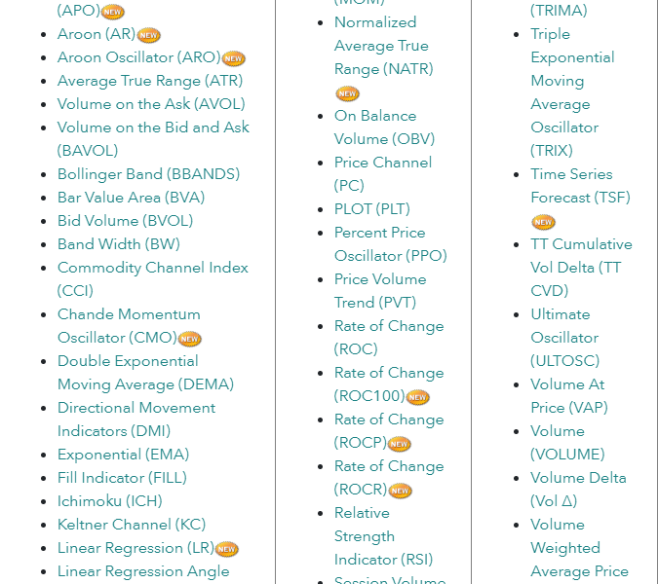
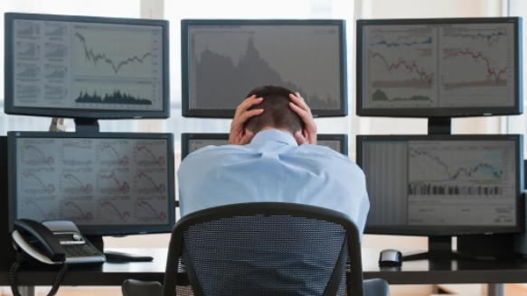
The Problem With Trading

Slide 3

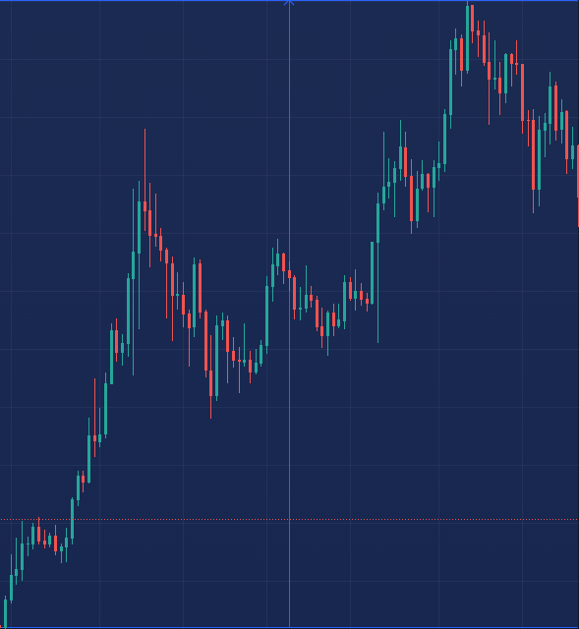
Predicting the Start of Price Trend
Our project focuses on selecting the best indicator to predict the beginning of an impulse or correction wave. We plan to do this by using Python data analytics packages for a crypto currency called Solana.
* All graphs were plotted by Jamel Boyer via his personal TradingView account.
Start of the Wave in Dec 2020 to the completion in Nov 2021 there was %490 increase in price over that period in time.

Slide 4
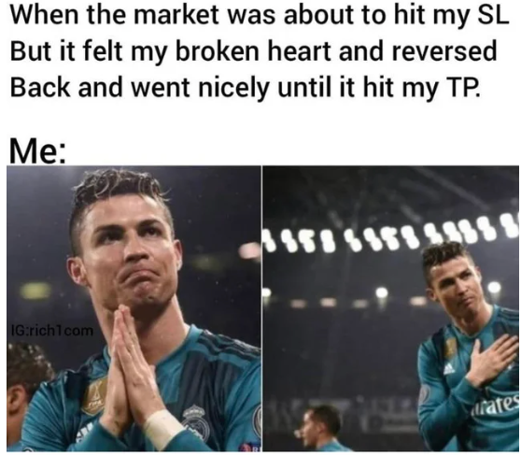
Take the Emotion Out of Trading
Elliott Wave Theory is one of the tools of technical analysis based on the psychology of individuals; which in recent years has become an important tool for analysts and investors. This theory exists in all financial markets, especially the stock market, which is widely welcomed and popular.
Total index data from 2008-05-14 to 2020-11-25 of the Tehran Stock Exchange index were reviewed daily. The study of the identified Elliott Waves and support vector machine and decision tree algorithms are able to predict the future trend of the total index with an accuracy of over 90 percent.
https://jfr.ut.ac.ir/article_82176.html?lang=en

Slide 5
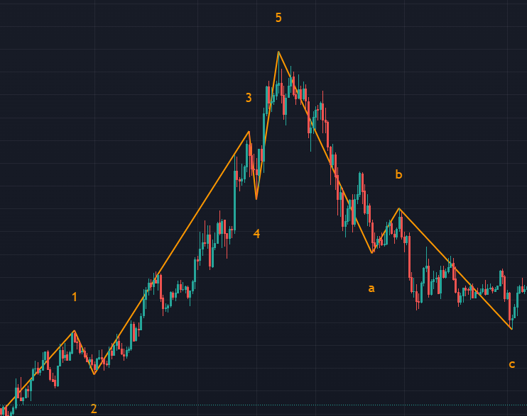
Riding the Elliott Wave
The Elliott wave theory states that each move in the direction of the trend regardless of whether it is up or down there are 5 waves that are called as impulse waves.
Since price doesn't move in a straight line these five waves would be interspersed with 3 smaller waves in the opposite direction that are called as corrective waves.
https://www.investopedia.com/terms/e/elliottwavetheory.asp
Price Dec 2020 - Feb 2022

Slide 6
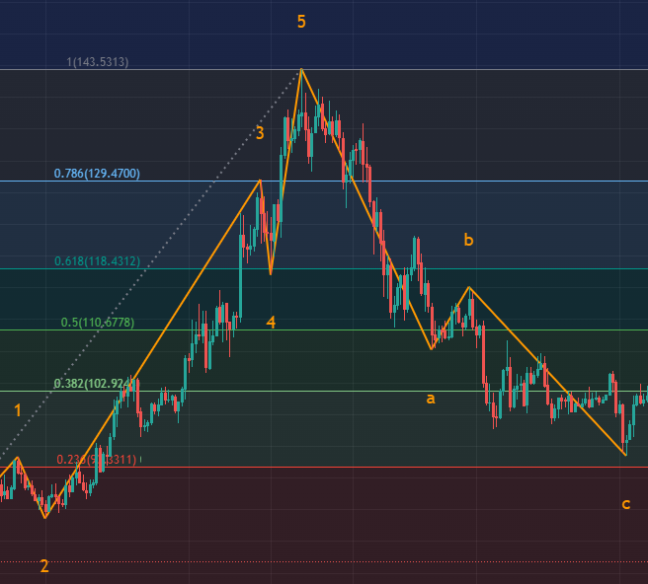
Retracements - Fibonacci
Usually, a correction tests one of the Fibonacci levels of the previous wave. The most common levels are 0.236, 0.382, 0.5, 0.618, 0.786. The last one is 0.618, which quite often turns out to be a useful level.
https://fbs.com/analytics/guidebooks/fibonacci-tools-60
Price Dec 2020 - Feb 2022

Slide 7
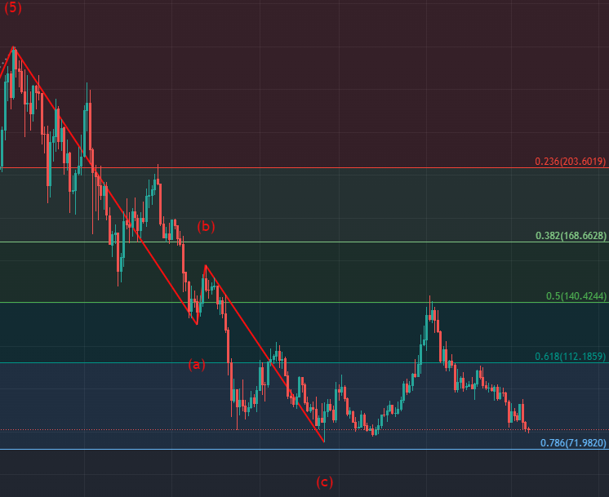
Predicting Wave 1 & the Uptrend
The ultimate objective is to eliminate confusion for the retail merchant and provide buy and sell signals using indicators, and the price trend strategy previously discussed using machine learning.
Price Feb 2022 - May 2022

Slide 8
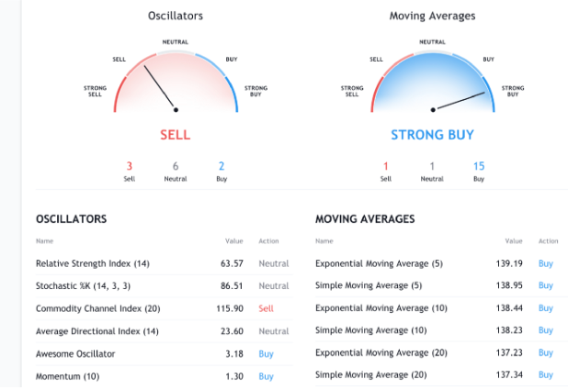
Confused - Don’t be! We Are Here to Help…
Step 1: Find an indicator that best predicts the price that is in correlation with our strategy.
Let's go over some of our initial codes and outputs.
https://peijin.medium.com/my-recent-experiments-have-been-focused-on-financial-time-series-forecasting-prediction-using-a-36a3202126c

